Slide 1
Project Review – I Helmet and Number Plate Detection
Team ID: C22
Team members:
1602-20-737-125
J.Aruna
1602-20-737-143
Ch.Mahesh
Ms.L.Divya
Assistant Professor Internal Guide

Slide 2
PROBLEM STATEMENT
Develop a comprehensive computer vision system capable of detecting helmet usage, identifying instances of triple riding, and recognizing vehicle number plates. This system aims to enhance road safety and enforce traffic regulations by accurately detecting helmets on motorbike riders, identifying overcrowded motorcycles, and automating the process of capturing vehicle registration information for law enforcement and traffic management purposes.

Slide 3
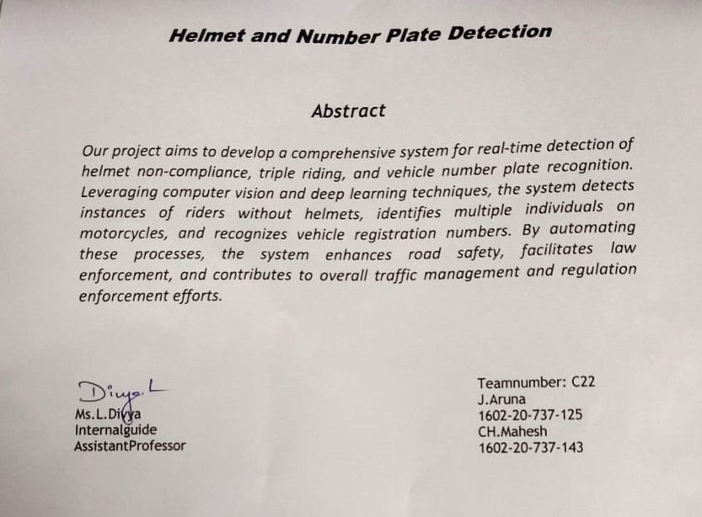
Abstract

Slide 4
LITERATURE SURVEY
S no. | Title | Year of publication | Observation
1 | Real-Time license plate detection for non-helmeted motorcyclist using YOLO | 2020 | .This paper uses the YOLO (a object detection algorithm) .To eliminate the false positive rate , Centroid tracking method is used. .Accuracy is 95.92%
2 | Two-Wheeler Vehicle Traffic Violations Detection and Automated Ticketing for Indian Road Scenario | 2022 | .This paper uses YOLOV4 for object detection and for object tracking DeepSort is used. .Number plate is Extracting with OCR- Tesseract .Accuracy for violation detection and Number plate detection are 98.09% and 99.41%

Slide 5
PROPOSED METHODOLOGY
Existing systems uses multiple stages of detection so we are
going to reduce it to at most 2-stage detection, which reduces
overall computational time and complexity.
We will be using Easy-OCR for character recognition which has better preprocessing methods and Deep learning models.
Canny Edge algorithm gives better edge detection for character segmentation than any other edge detection algorithms.

Slide 6
PROPOSED METHODOLOGY
GrayScaling :
Grayscaling is the process of converting an image from other color spaces e.g. RGB, HSV, etc. to shades of gray.
It reduces the complexity of the image by representing it in shades of gray, which can make certain image processing tasks, such as edge detection and image segmentation, easier and more efficient.
Grayscale images also require less memory and computational resources compared to color images, making them faster to process.
Canny Edge Detection :
Canny edge detection is a popular image processing technique used to find the edges or boundaries of objects in an image.
Canny edge detection is a pre-processing step that can be used to enhance the edges of objects in an image, making them more distinguishable.

Slide 7
SYSTEM REQUIREMENTS
Software Requirements :
1.python 3.7
2.Tensor Flow
3.Visual studio
Hardware Requirements :
1.Recommended operating system : Windows or Linux
2.Windows:Windows10 or above
3.Processor:Recommended 4GHz or more
4.RAM:8GB or more

Slide 8
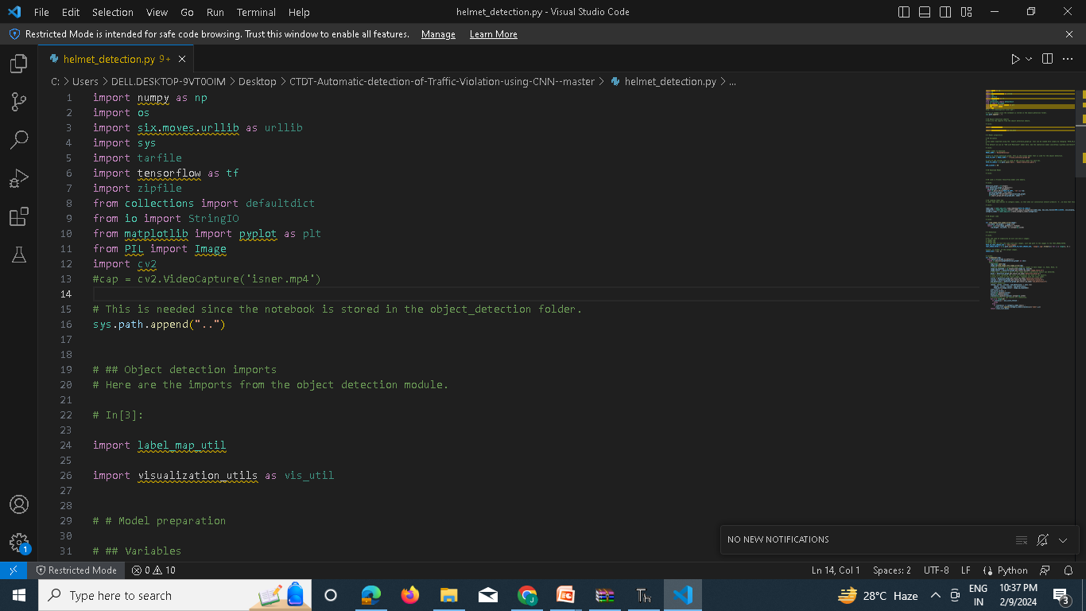
IMPLEMENTATION CODE

Slide 9
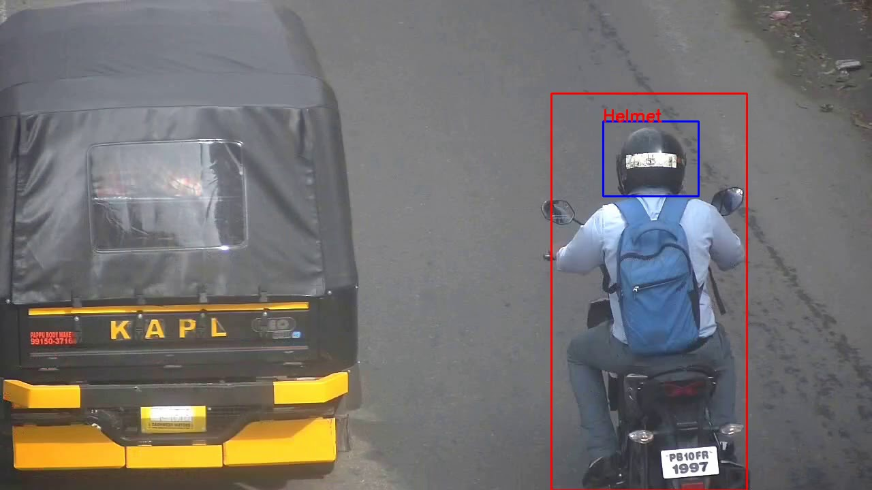
EXPECTED OUTPUT

Slide 10
FUTURE SCOPE
-> The Project further extended to detect the number plate and triple ride violation.

Slide 11
REFERENCES
[1] Yonten Jamtshoa, Panomkhawn Riyamongkol, Rattapoom Waranusast,“ Real-timelicense plate detection for non-helmeted motorcyclist using YOLO”, Elsevier-Journal ofBusiness Research Volume-7,March 2021.
[2] R.Shree Charran , Rahul Kumar Dubey,“ Two-Wheeler Vehicle Traffic ViolationsDetection and Automated Ticketing for Indian Road Scenario”, IEEE Transactions onIntelligent Transportation Systems Volume-23,November 2022.
[3] Aashik Mathew P, Anoohya , BharathwajN, K.Jaspin,“ Real-Time Number Plate andHelmet Detection of Motorcyclists using YOLOv5 and ResNet-50”, Proceedings of theInternational Conference on Sustainable Computing and Data Communication Systems,March 2023.
[4] Aditi Rao, Aditya Singh, Ritika Nair and Abhilash Poojary, “Helmet Detection And Number Plate Recognition Using Deep Learning” ,2022 IEEE Region 10 Symphosium (TENSYMP).

Slide 12
REFERENCES
[5] R Vedhaviyassh, R Sudhan, G Saranya, M Safa and D Arun, “Comparative Analysis of EasyOCR and TesseractOCR for Automatic License Plate Recognition using Deep Learning Algorithm”, Proceedings of the Sixth International Conference on Electronics, Communication and Aerospace Technology, December 2022.
[6] Aashik MathewP, Anoohya Jagarlamudi, Bharathwaj N and Mrs. K. Jaspin, “Real-Time Number Plate and Helmet Detection of Motorcyclists using YOLOv5 and ResNet-50”,International Conference on Sustainable Computing and Data Communication Systems, March 2023.

Slide 13
THANK YOU

